Slide 1
2. Neuron Model – Network Architectures –Learning
2.1 Neuron model
2.2 Activation functions
2.3 Network architectures
2.4 Learning algorithms
2.5 Learning paradigms
2.6 Learning tasks
2.7 Knowledge representation
2.8 Generalization and model complexity
2.9 Neural networks vs. statistical methods
2.10 MATLAB Live Script examples

Slide 2
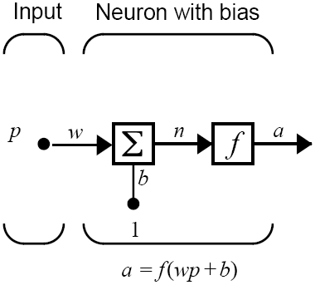
2.1 Neuron model
Neuron
information processing unit that is fundamental to the operation of a neural network
Single input neuron
scalar input x
synaptic weight w
bias b
adder or linear combiner Σ
activation potential v
activation function f
neuron output y
Adjustable parameters
synaptic weight w
bias b

Slide 3
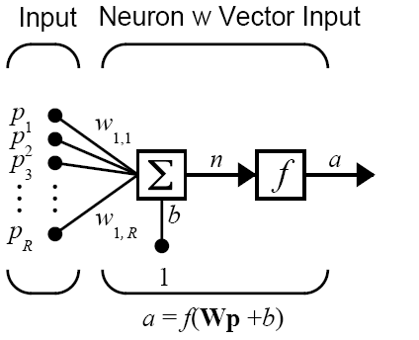
Neuron with vector input
Input vector
x = [x₁, x₂, ... x_{R} ], R = number of elements in input vector
Weight vector
w = [w₁, w₂, ... w_{R} ]
Activation potential
v = w x + b
product of input vector and
weight vector

Slide 4
2.2 Activation functions (1/2)
Activation function defines the output of a neuron
Types of activation functions
Threshold function Linear function Sigmoid function

Slide 5
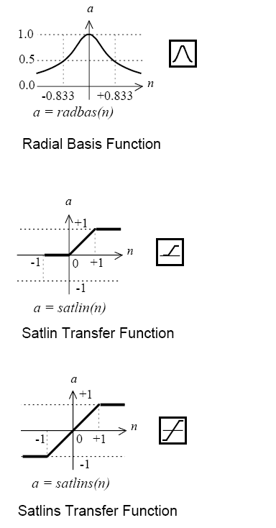
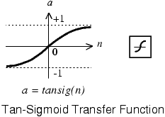
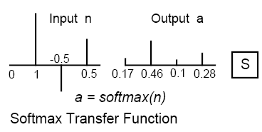
Activation functions (2/2)
Notes:
MATLAB demo:
x=-10:.1:10
y=tansig(x)
y=1./(1+exp(-x))
plot(x,y), grid on

Slide 6
McCulloch-Pitts Neuron (1943)
Vector input, threshold activation function
Extremely simplified model of real biological neurons
Missing features: non-binary outputs, non-linear summation, smooth thresholding, stochasticity, temporal information processing
Nevertheless, computationally very powerful
Network of McCulloch-Pits neurons is capable of universal computation
The output is binary, depending on whether
the input meets a specified threshold

Slide 7
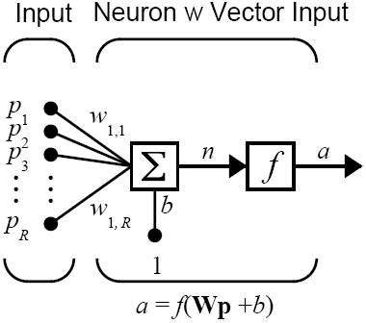
MATLAB notation
Presentation of more complex neurons and networks
Input vector p is represented by the solid dark vertical bar [R x 1]
Weight vector is shown as single-row, R-column matrix W [1 x R]
p and W multiply into scalar Wp

Slide 8
2.3 Network architectures
About network architectures
Two or more of the neurons can be combined in a layer
Neural network can contain one or more layers
Strong link between network architecture and learning algorithm
Single-layer feedforward networks
Input layer of source nodes projects onto an output layer of neurons
Single-layer refers to the output layer (the only computation layer)
Multi-layer feedforward networks
One or more hidden layers
Can extract higher-order statistics
Recurrent networks
Contains at least one feedback loop
Powerfull temporal learning capabilities
Notes:
Haykin p.21

Slide 9
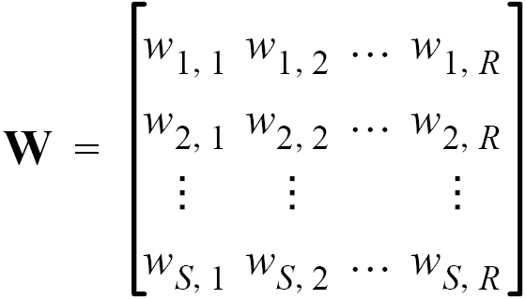
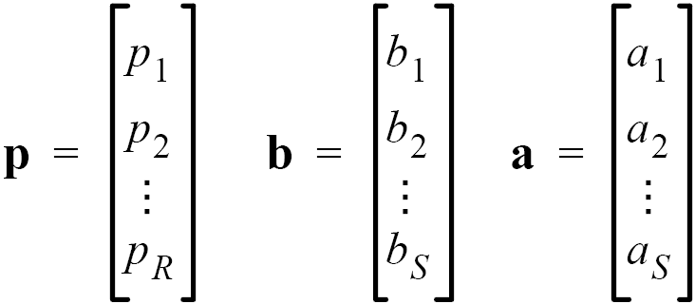
Single-layer feedforward networks

Slide 10
Multi-layer feedforward networks (1/2)

Slide 11
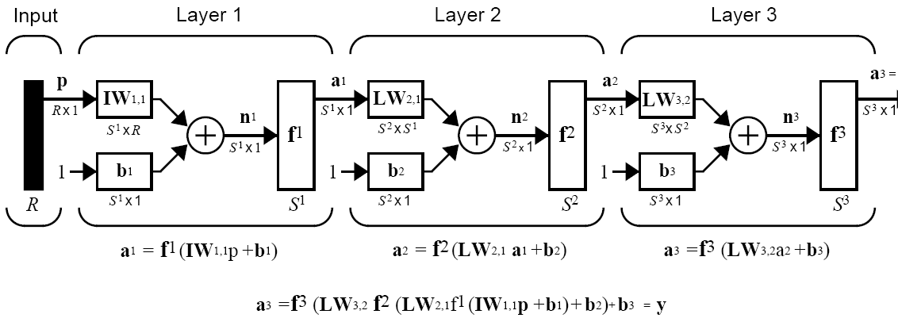
Multi-layer feedforward networks (2/2)
Data flow strictly feedforward: input → output
No feedback → Static network, easy learning

Slide 12
Recurrent networks (1/2)
Also called “Dynamic networks”
Output depends on
current input to the network (as in static networks)
and also on current or previous inputs, outputs, or states of the network
Simple recurrent network
Delay
Feedback loop
Notes:
Explain that time t is DISCRETE (in steps: t, t+1, t+1, …). Step size depends on the application.

Slide 13
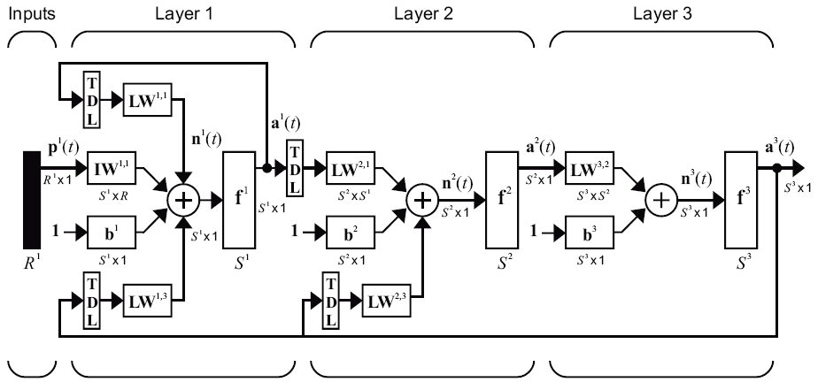
Recurrent networks (2/2)
Layered Recurrent Dynamic Network – example

Slide 14
2.4 Learning algorithms
Important ability of neural networks
To learn from its environment
To improve its performance through learning
Learning process
Neural network is stimulated by an environment
Neural network changes its free parameters as a result of this stimulation
Neural network responds in a new way to the environment because of its changed internal structure
Learning algorithm
Prescribed set of defined rules for the solution of a learning problem
Error correction learning
Memory-based learning
Hebbian learning
Competitive learning
Notes:
Haykin p.50

Slide 15
Error-correction learning (1/2)
Neural network is driven by input x(t) and responds with output y(t)
Network output y(t) is compared with target output d(t)
Error signal = difference between network output and target output
d(t)
y(t)
x(t)
e(t)

Slide 16
Error-correction learning (2/2)
Error signal → control mechanism to correct synaptic weights
Corrective adjustments → designed to make network output y(t) closer to target d(t)
Learning achieved by minimizing instantaneous error energy
Delta learning rule (Widrow-Hoff rule)
Adjustment to a synaptic weight of a neuron is proportional to the product of the error signal and the input signal of the synapse
Comments
Error signal must be directly measurable
Key parameter: Learning rate η
Closed-loop feedback system → Stability determined by learning rate η

Slide 17
Memory-based learning
All (or most) past experiences are stored in a memory of input-output pairs (inputs and target classes)
Two essential ingredients of memory-based learning
Define the local neighborhood of a new input x_{new}
Apply learning rule to adapt stored examples in the local neighborhood of x_{new}
Examples of memory-based learning
Nearest neighbor rule
Local neighborhood defined by the nearest training example (Euclidian distance)
K-nearest neighbor classifier
Local neighborhood defined by k-nearest training examples → robust against outliers
Radial basis function network
Selecting the centers of basis functions

Slide 18
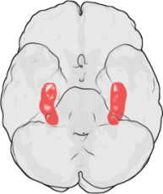

Hebbian learning
The oldest and most famous learning rule (Hebb, 1949)
Formulated as associative learning in a neurobiological context
“When an axon of a cell A is near enough to excite a cell B and repeatedly or persistently takes part in firing it, some growth process or metabolic changes take place in one or both cells such that A’s efficiency as one of the cells firing B, is increased.”
Strong physiological evidence for Hebbian learning in the hippocampus, important for long-term memory and spatial navigation
Hebbian learning (Hebbian synapse)
Time-dependent, highly local, and strongly interactive mechanism to increase synaptic efficiency as a function of the correlation between the presynaptic and postsynaptic activities.
If two neurons on either side of a synapse are activated simultaneously, then the strength of that synapse is selectively increased
If two neurons on either side of a synapse are activated asynchronously, then that synapse is selectively weakened or eliminated
The simplest form of Hebbian learning
Notes:
http://en.wikipedia.org/wiki/Hebbian_learning

Slide 19
Competitive learning
Inputs
Competitive learning network architecture
Set of inputs, connected to a layer of outputs
Each output neuron receives excitation from all inputs
Output neurons of a neural network compete to become active by exchanging lateral inhibitory connections
Only a single neuron is active at any time
Competitive learning rule
Neuron with the largest induced local field becomes a winning neuron
Winning neuron shifts its synaptic weights toward the input
Individual neurons specialize in ensembles of similar patterns → feature detectors for different classes of input patterns

Slide 20
2.5 Learning paradigms
Learning algorithm
Prescribed set of defined rules for the solution of a learning problem
Learning paradigm
Manner in which a neural network relates to its environment
Supervised learning
Unsupervised learning
Reinforcement learning
Error correction learning
Memory-based learning
Hebbian learning
Competitive learning

Slide 21
Supervised learning
Learning with labeled training data
Labeled training data provide knowledge of the environment
Data are represented by a set of input-output examples
Learning algorithms
Error-correction learning
Memory-based learning
Environment
Labeled training data
Target response = optimal action
+
Learning system
Σ
-
Error signal

Slide 22
Unsupervised learning
Unsupervised or self-organized learning
No external "teacher" to oversee the learning process
Only a set of input examples is available, no output examples
Unsupervised NNs usually perform some kind of data compression, such as dimensionality reduction or clustering
Learning algorithms
Hebbian learning
Competitive learning
Environment
Learning system
Notes:
Kevin Warvick: rat brained robots
http://www.youtube.com/watch?v=1-0eZytv6Qk

Slide 23
Reinforcement learning
No teacher, environment only offers primary reinforcement signal
System learns under delayed reinforcement
Temporal sequence of inputs which result in the generation of a reinforcement signal
Goal is to minimize the expectation of the cumulative cost of actions taken over a sequence of steps
RL is realized through two neural networks: Critic and Learning system
Critic network converts primary reinforcement signal (obtained directly from the environment) into a higher quality heuristic reinforcement signal which solves temporal credit assignment problem
Primary reinforcement
Environment
Critic
Heuristic reinforcement
Learning system
Actions

Slide 24
2.6 Learning tasks (1/7)
Pattern Association
Associative memory is brain-like distributed memory that learns by association
Two phases in the operation of associative memory
Storage
Recall
Autoassociation
Neural network stores a set of patterns by repeatedly presenting them to the network
Then, when presented distored pattern, a neural network can recall the original pattern
Unsupervised learning algorithms
Heteroassociation
Set of input patterns is paired with an arbitrary set of output patterns
Supervised learning algorithms
Notes:
Autoassociation: recognize faces
Heteroassociation: associate names with faces

Slide 25
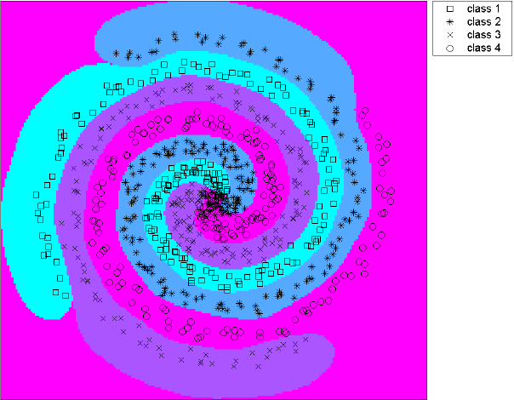
Learning tasks (2/7)
Pattern Recognition
In pattern recognition, input signals are assigned to categories (classes)
Two phases of pattern recognition
Learning (supervised)
Classification
Statistical nature of pattern recognition
Patterns are represented in multi-dimensional decision space
Decision space is divided by separate regions for each class
Decision boundaries are determined by a learning process
Support-Vector-Machine example

Slide 26
Learning tasks (3/7)
Function Approximation
Arbitrary nonlinear input-output mapping y = f(x) can be approximated by a neural network, given a set of labeled examples {x_{i}, y_{i}}, i=1,..,N
The task is to approximate the mapping f(x) by a neural network F(x) so that f(x) and F(x) are close enough
||F(x) – f(x)|| < ε for all x, (ε is a small positive number)
Neural network mapping F(x) can be realized by supervised learning (error-correction learning algorithm)
Important function approximation tasks
System identification
Inverse system

Slide 27
Learning tasks (4/7)
System identification
Inverse system
Environment
Unknown System
Unknown system response
+
Neural network
Σ
-
Error signal
Inputs from the environment
+
Environment
System
Neural network
Σ
-
Error signal

Slide 28
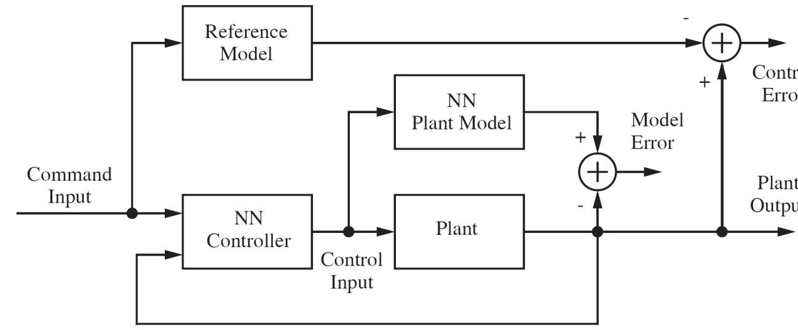
Learning tasks (5/7)
Control
Neural networks can be used to control a plant (a process)
Brain is the best example of a parallel distributed generalized controller
Operates thousands of actuators (muscles)
Can handle nonlinearity and noise
Can handle invariances
Can optimize over a long-range planning horizon
Feedback control system (Model reference control)
NN controller has to supply inputs that will drive a plant according to a reference
Notes:
http://en.wikipedia.org/wiki/Adaptive_control

Slide 29
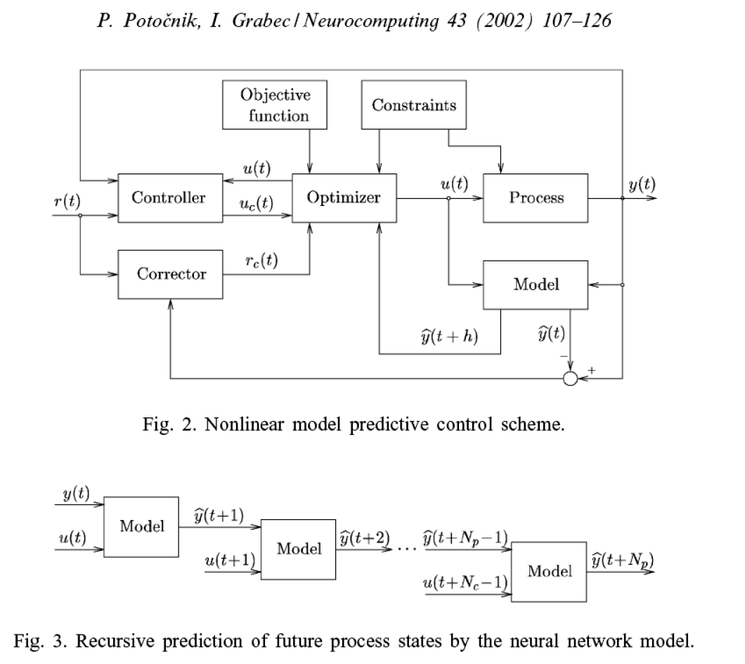
Model predictive control
NN model provides multi-step ahead predictions for the optimizer
Notes:
Images: https://doi.org/10.1016/S0925-2312(01)00623-3

Slide 30
Learning tasks (6/7)
Filtering
Filter – device or algorithm used to extract information about a prescribed quantity of interest from a noisy data set
Filters can be used for three basic information processing tasks:
Filtering
Extraction of information at discrete time n by using measured data up to and including time n
Examples: Cocktail party problem, Blind source separation
Smoothing
Differs from filtering in:
Data need not be available at time n
Data measured later than n can be used to obtain this information
Prediction
Deriving information about the quantity in the future at time n+h, h>0, by using data measured up to including n
Example: Forecasting of energy consumption, stock market prediction
o o o o o o o o o o
o o o o o o x o o o
o o o o o o o o o o x

Slide 31
Learning tasks (7/7)
Beamforming
Spatial form of filtering, used to distinguish between the spatial properties of a target signal and background noise
Device is called a beamformer
Beamforming is used in human auditory response and echo-locating bats → the task is suitable for neural network application
Common beamforming tasks: radar and sonar systems
Task is to detect a target in the presence of receiver noise and interfering signals
Target signal originates from an unknown direction
No a priori information available on interfering signals
Neural beamformer, neuro-beamformer, attentional neurocomputers

Slide 32
Adaptation
Learning has spatio-temporal nature
Space and time are fundamental dimensions of learning (control, beamforming)
Stationary environment
Learning under the supervision of a teacher, weights are then frozen
Neural network then relies on memory to exploit past experiences
Nonstationary environment
Statistical properties of the environment change with time
Neural network should continuously adapt its weights in real-time
Adaptive system → continuous learning
Pseudostationary environment
Changes are slow over a short temporal window
Speech – stationary in an interval of 10-30 ms
Ocean radar – stationary within of several seconds

Slide 33
2.7 Knowledge representation
What is knowledge?
Stored information or models used by a person or machine to interpret, predict, and appropriately respond to the outside world (Fischler & Firschein, 1987)
Knowledge representation
Good solution depends on a good representation of knowledge
Knowledge of the world consists of:
Prior information – facts about what is and what has been known
Observations of the world – measurements, obtained through sensors designed to probe the environment
Observations can be:
Labeled – input signals are paired with desired response
Unlabeled – input signals only
Notes:
Haykin p.24

Slide 34
Knowledge representation in NN
Design of neural networks based directly on real-life data
Examples to train the neural network are taken from observations
Examples to train neural networks can be
Positive examples ... input and correct target output
e.g. sonar data + echos from submarines
Negative examples ... input and false output
e.g. sonar data + echos from marine life
Knowledge representation in neural networks
Defined by the values of free parameters (synaptic weights and biases)
Knowledge is embedded in the design of a neural network
Interpretation problem – neural networks suffer from an inability to explain how a result (decision / prediction / classification) was obtained
Serious limitation for safety-critical application (medical diagnosis, air traffic)
Explanation capability by integration of NN and other artificial intelligence methods

Slide 35
Knowledge representation rules for NN
Rule 1 Similar inputs from similar classes should produce similar representations inside the network and should be classified into the same category
Rule 2 Items to be categorized as separate classes should be given widely different representations in the network
Rule 3 If a particular feature is important, then there should be a large number of neurons involved in the representation of that item in the network
Rule 4 Prior information and invariances should be built into the design of a neural network, thereby simplifying the network design by not having to learn them

Slide 36
Prior information and invariances (Rule 4)
Application of Rule 4 results in neural networks with specialized structure
Biological visual and auditory networks are highly specialized
Specialized network has a smaller number of parameters
needs less training data
faster learning
faster network throughput
cheaper because of its smaller size
How to build prior information into neural network design
Currently no well-defined rules, but useful ad-hoc procedures
We may use a combination of two techniques
Receptive fields → restricting the network architecture by using local connections
Weight-sharing → several neurons share the same synaptic weights

Slide 37
How to build invariances into NN
Character recognition example
Transformations → Pattern recognition system should be invariant to them
Techniques
Invariance by neural network structure
Invariance by training
Invariant feature space
Original Size Rotation Shift Incomplete image

Slide 38
Invariant feature space
Neural net classifier with invariant feature extractor
Features
Characterize the essential information content of an input data
Should be invariant to transformations of the input
Benefits
Dimensionality reduction – number of features is small compared to the original input space
Relaxed design requirements for a neural network
Invariances for all objects can be assured (for known transformations) → Prior knowledge is required!
Invariant feature extractor
Neural network classifier
Input Class estimate

Slide 39

Example 2A (1/4) Invariant character recognition
Problem: distinguishing handwritten characters ‘a’ and ‘b’
Classifier design
Image representation
Grid of pixels (typically 256x256) with gray level [0..1] (typically 8-bit coding)
Invariant feature extractor
Neural network classifier
Class estimate: ‘A’, ‘B’

Slide 40
Example 2A (2/4) Problems with image representation
Invariance problem (various transformations)
High dimensionality problem
Image size 256x256 → 65536 inputs
Curse of dimensionality – increasing input dimensionality leads to sparse data and this provides a very poor representation of the mapping
→ problems with correct classification and generalization
Possible solution
Combining inputs into features → Goal is to obtain just a few features instead of 65536 inputs
Ideas for feature extraction (for character recognition)

Slide 41
Example 2A (3/4) Feature extraction
Extracted feature:
Distribution for various samples from class ‘A’ and ‘B’
Overlapping distributions: the need for additional features
F₁, F₂, F₃, ...
Decision
Class ‘A’ Class ‘B’
samples from
class ‘A’
samples from
class ‘B’
F₁

Slide 42
Example 2A (4/4) Classification in multi-feature space
Classification in the space of two features (F₁, F₂)
Neural network can be used for classification in the feature space (F₁, F₂)
2 inputs instead of 65536 original inputs
Improved generalization and classification ability
F₂
samples from
class ‘A’
Decision boundary
samples from
class ‘B’
F₁

Slide 43
2.8 Generalization and model complexity
What is the optimal decision boundary?
Best generalization is achieved by a model whose complexity is neither too small nor too large
Occam’s razor principle: we should prefer simpler models to more complex models
Tradeoff: modeling simplicity vs. modeling capacity
Linear classifier is insufficient, false classifications
Optimal classifier
Over-fitting, correct classification but poor generalization

Slide 44
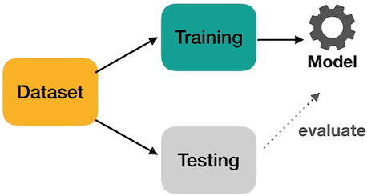
Cross-Validation
Cross-Validation (CV) approach is most often used to estimate the model‘s generalization performance:
Data are split into 2 subsets
Training subset ….. (e.g. 80% of data)
Testing subset …… (e.g. 20% of data)
Training subset is further divided into
Learning subset …. (e.g. 60% of data)
Validation subset … (e.g. 20% of data)
Learning and Validation subsets are used to train and validate the model
Learning & validation can be repeated with various model hyperparameters until a good validation result is obtained
Finally, testing subset is used to estimate the generalization performance on new data (which were not used during training)
The final data splitting is thus
Learning subset …. (e.g. 60% of data)
Validation subset … (e.g. 20% of data)
Testing subset …… (e.g. 20% of data)
Notes:
Picture: https://towardsdatascience.com/what-is-cross-validation-60c01f9d9e75

Slide 45
2.9 Neural networks vs. stat. methods (1/3)
Considerable overlap between neural nets and statistics
Statistical inference means learning to generalize from noisy data
Feedforward nets are a subset of the class of nonlinear regression and discrimination models
Application of statistical theory to neural networks: Bishop (1995), Ripley (1996)
Most NN that can learn to generalize effectively from noisy data are similar or identical to statistical methods
Single-layered feedforward nets are generalized linear models
Two-layer feedforward nets are closely related to projection pursuit regression
Probabilistic neural nets are identical to kernel discriminant analysis
Kohonen nets for adaptive vector quantization are similar to k-means cluster analysis
Kohonen self-organizing maps are discrete approximations of principal curves and surfaces
Hebbian learning is closely related to principal component analysis
Some neural network areas have no relation to statistics
Reinforcement learning
Stopped training (similar to shrinkage estimation, but the method is quite different)

Slide 46
Neural networks vs. statistical methods (2/3)
Many statistical methods can be used for flexible nonlinear modeling
Polynomial regression, Fourier series regression
K-nearest neighbor regression and discriminant analysis
Kernel regression and discriminant analysis
Wavelet smoothing, Local polynomial smoothing
Smoothing splines, B-splines
Tree-based models (CART, AID, etc.)
Multivariate adaptive regression splines (MARS)
Projection pursuit regression, various Bayesian methods
Why use neural nets rather than statistical methods?
Multilayer perceptron (MLP) tends to be useful in similar situations as projection pursuit regression, i.e.:
the number of inputs is fairly large,
many of the inputs are relevant, but
most of the predictive information lies in a low-dimensional subspace
Some advantages of MLPs over projection pursuit regression
computing predicted values from MLPs is simpler and faster
MLPs are better at learning moderately pathological functions than are many other methods with stronger smoothness assumptions

Slide 47
Neural networks vs. statistical methods (2/3)
Neural Network Jargon
Generalizing from noisy data ....................................
Neuron, unit, node ....................................................
Neural networks .......................................................
Architecture ..............................................................
Training, Learning, Adaptation .................................
Classification ............................................................
Mapping, Function approximation ............................
Competitive learning .................................................
Hebbian learning ......................................................
Training set ...............................................................
Input .........................................................................
Output .......................................................................
Generalization ..........................................................
Prediction .................................................................
Statistical Jargon
Statistical inference
A simple linear or nonlinear computing element that accepts one or more inputs and computes a function thereof
A class of flexible nonlinear regression and discriminant models, data reduction models, and nonlinear dynamical systems
Model
Estimation, Model fitting, Optimization
Discriminant analysis
Regression
Cluster analysis
Principal components
Sample, Construction sample
Independent variables, Predictors, Regressors, Explanatory variables, Carriers
Predicted values
Interpolation, Extrapolation, Prediction
Forecasting

Slide 48
2.10 MATLAB Live Script examples
NN2b_Neuron_output.mlx
Simulation of a single neuron output
NN2c_Custom_architecture.mlx
Create and view custom neural network architecture

